Slide 1
Kern NON-DISTRICTED LANDS AUTHORITY
SGMA Overview
Jenny Holtermann
Executive director
jenny@kndla.org
Notes:
SPEAKER: Anona
The Final 2024 Plan represents no less that a herculean, multi-year and multi-million dollar investment to develop a comprehensive Groundwater Sustainability Plan that is
founded in the best available data and science,
anchored by a set guiding principles, and
presents a unified vision across the largest and most complex groundwater basin in California.

Slide 2
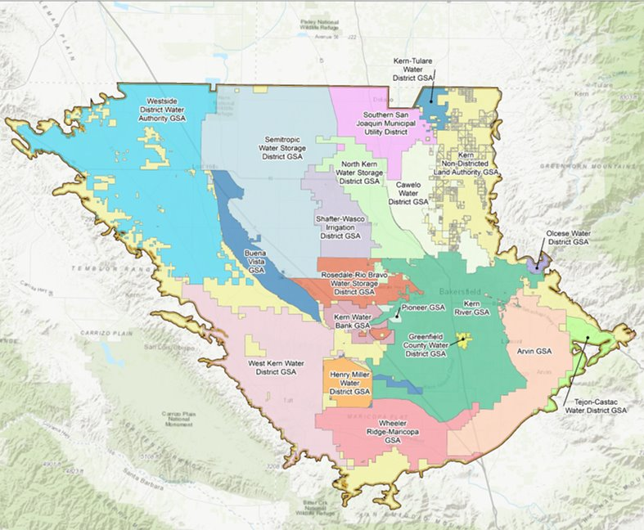
Subbasin Overview
1.782 million acres – the largest Subbasin in the State
Based on acreage, the following could fit within the Kern County Subbasin:
  40 of the 71 approved basins across California, or
  6 of the 9 of the approved basins in the Central Valley, or
  4 of the other Inadequate subbasins (Tule, Tulare Lake, Kaweah, and Chowchilla) combined
Over 35 water agencies represented
Notes:
SPEAKER: Anona
So to begin our more detailed discussion of the Final 2024 Plan, I just want to take a minute to comment on SCALE.
You will probably hear some numbers today and see some in the Plan that will seem very large – like our overdraft mitigation targets, or the number of GSAs – and others that are relatively small – like the number of wells that will potentially be impacted.
The Kern County Subbasin spans approximately 1.78 million acres, making it the largest in California (by far).
To put that in perspective – 40 of the 71 basins with approved GSPs (many with multiple GSAs) could fit within the Kern Subbasin. So by those standards realistically a minimum of 40+ GSAs and GSPs could be managing the basin as opposed to the Unified Final 2024 Plan that the GSAs coordinated to develop.
Also 6 of the 9 approved basins in the CV or 4 of the 6 inadequate basins could all fit within Kern – highlighting again just the significant volume of resources and beneficial uses and users that are actively being considered and managed within this 2024 Plan.
This plan also reflects the input and commitments of over 35 water agencies, with extensive coordination between drinking water and agricultural water suppliers and users.

Slide 3
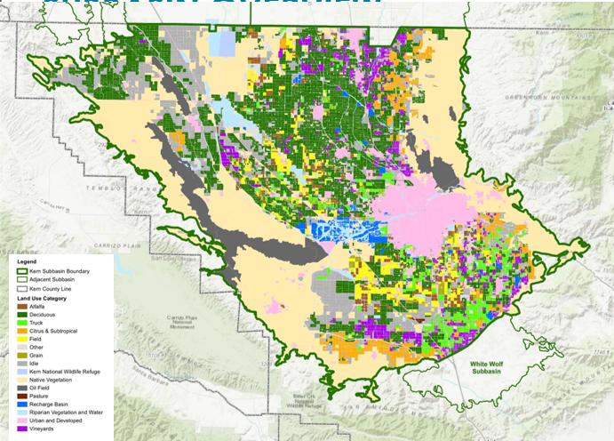
SUBBASIN OVERVIEW
Majority of the 657,000 acres of irrigated lands have access to surface water supplies
~920,000 acres are native, idle, or conservation lands
149,000 acres of urban, suburban, and rural communities
91,000 acres of oil fields
Notes:
SPEAKER: Anona
Not only is the Kern Subbasin the largest in the state, it has a wide variety of land and water uses and a long history of conjunctive use – through the importation, banking and management of surface water supplies from Federal, State and local sources.
The multiple water banks that operate in the Basin support local, regional and statewide reliability, and are key to not only the successful implementation of this GSP, but to others across the state.
Just to speak further to the dynamic nature of this basin, the City of Bakersfield is one of the top 10 largest and fastest growing cities in California and the high value ag produced here is vital part of California’s economy.
Given all this – one thing we all have to keep in mind is that this basin’s near- and ling-term success is material to the success of several other basins and the state as a whole.

Slide 4
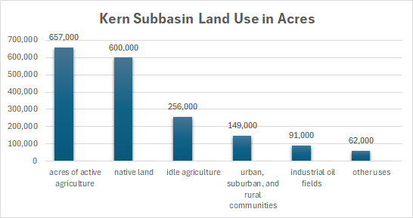
SUBBASIN OVERVIEW
Notes:
SPEAKER: Anona
Not only is the Kern Subbasin the largest in the state, it has a wide variety of land and water uses and a long history of conjunctive use – through the importation, banking and management of surface water supplies from Federal, State and local sources.
The multiple water banks that operate in the Basin support local, regional and statewide reliability, and are key to not only the successful implementation of this GSP, but to others across the state.
Just to speak further to the dynamic nature of this basin, the City of Bakersfield is one of the top 10 largest and fastest growing cities in California and the high value ag produced here is vital part of California’s economy.
Given all this – one thing we all have to keep in mind is that this basin’s near- and ling-term success is material to the success of several other basins and the state as a whole.

Slide 5
Kern county water Overview
Source of Water | Percent | Average Year
Kern River | 21% | 700,000
State Water Project | 21% | 700,000
Federal CVP | 12% | 400,000
Other Sources | 15% | 500,000
Groundwater | 31% | 1,100,000
TOTAL |  | 3,400,000
2024
581,480
989,672
393,258
168,084
1,179,906
3,312,399
Notes:
SPEAKER: Anona
So to begin our more detailed discussion of the Final 2024 Plan, I just want to take a minute to comment on SCALE.
You will probably hear some numbers today and see some in the Plan that will seem very large – like our overdraft mitigation targets, or the number of GSAs – and others that are relatively small – like the number of wells that will potentially be impacted.
The Kern County Subbasin spans approximately 1.78 million acres, making it the largest in California (by far).
To put that in perspective – 40 of the 71 basins with approved GSPs (many with multiple GSAs) could fit within the Kern Subbasin. So by those standards realistically a minimum of 40+ GSAs and GSPs could be managing the basin as opposed to the Unified Final 2024 Plan that the GSAs coordinated to develop.
Also 6 of the 9 approved basins in the CV or 4 of the 6 inadequate basins could all fit within Kern – highlighting again just the significant volume of resources and beneficial uses and users that are actively being considered and managed within this 2024 Plan.
This plan also reflects the input and commitments of over 35 water agencies, with extensive coordination between drinking water and agricultural water suppliers and users.

Slide 6
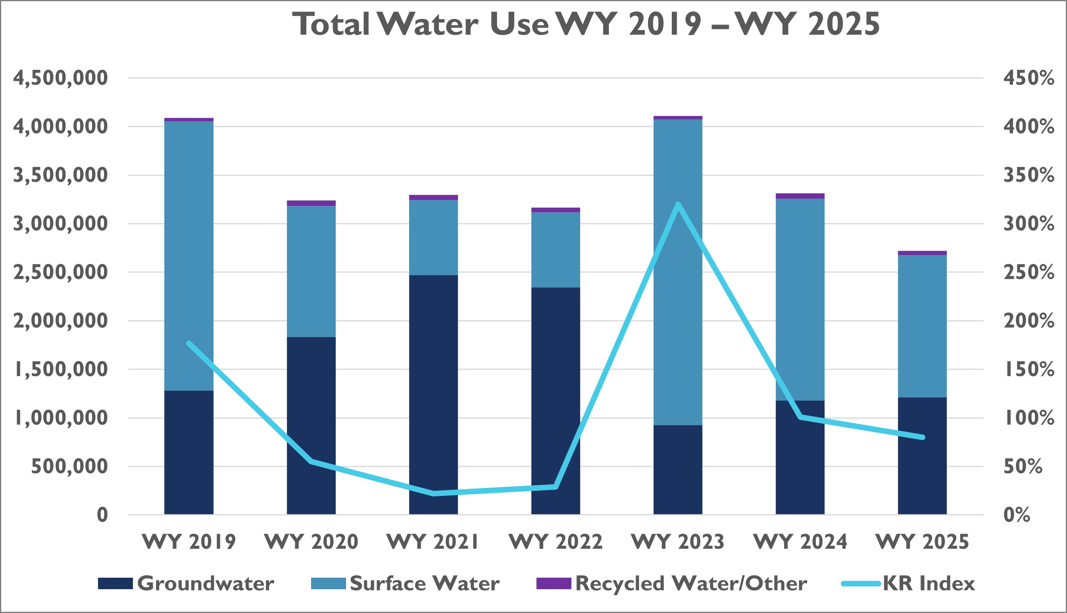
HISTORICAL WATER USE 2019-2025

Slide 7
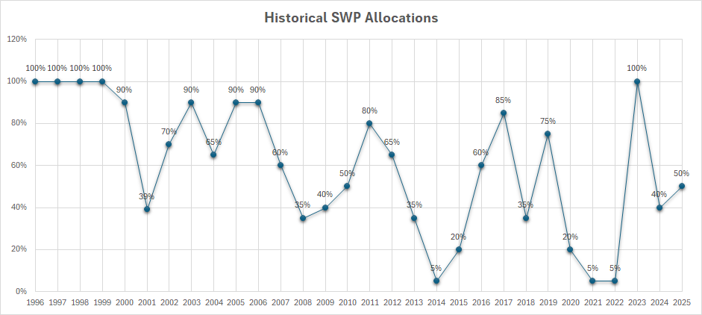
STATE WATER INSTABILITY

Slide 8
SUSTAINABLE GROUNDWATER MANAGEMENT ACT
Legislation passed in 2014, SGMA requires local agencies to form groundwater sustainability agencies (GSAs) for the high and medium priority basins.
  GSAs develop and implement plans to avoid undesirable results and mitigate overdraft within 20 years.
  Sustainable by 2040
  Regulatory oversight of plans and use of water.
  If plans demanded inadequate, State takes over
  Subsidence, overdraft, water quality, minimum threshold (lowest aquifer can fall)

Slide 9
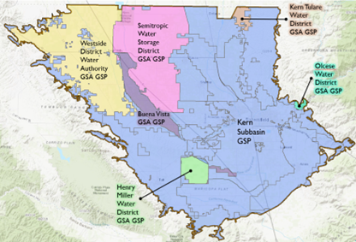
SGMA OVERVIEW
  Three plan submittals
    2020; 11 GSA, 5 GSP
    2022; 14 GSA, 6 GSP
    2023; DWR determined 2022 plan was inadequate- sent to SWB
    2024; 20 GSA, 7 GSP
    2025
      SWB sent back to DWR
      The 20 GSAs collaborated on a unified 2025 Amended GSP to protect all beneficial users, uses, and property interests in the Kern Subbasin
Notes:
SPEAKER: Anona
Not only is the Kern Subbasin the largest in the state, it has a wide variety of land and water uses and a long history of conjunctive use – through the importation, banking and management of surface water supplies from Federal, State and local sources.
The multiple water banks that operate in the Basin support local, regional and statewide reliability, and are key to not only the successful implementation of this GSP, but to others across the state.
Just to speak further to the dynamic nature of this basin, the City of Bakersfield is one of the top 10 largest and fastest growing cities in California and the high value ag produced here is vital part of California’s economy.
Given all this – one thing we all have to keep in mind is that this basin’s near- and ling-term success is material to the success of several other basins and the state as a whole.

Slide 10
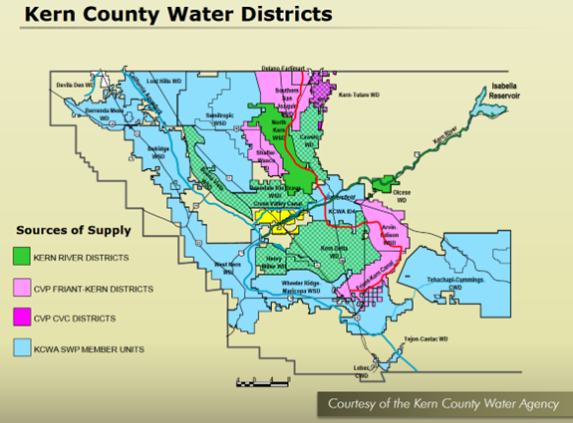
DIFFERENT WATER SOURCES = DIFFERENT IMPACT

Slide 11
KNDLA Overview
May 2024 KGA became KNDLA
The intent of KNDLA is to provide GSA and GSP coverage for non-districted land within the Kern Subbasin and, in some cases, offer regulatory jurisdiction to certain members for lands outside their service area boundaries of other GSA’s.
22 Directors, 21 Voting Members
20 Financial Contributors
EWMA was formed in May 2018 and is a non-profit corporation governed by a seven-member Board of Directors.
  This entity was formed to represent its members (46 landowners) under the GSA authority granted to the Kern Non-Districted Land Authority. EWMA is working to become a public agency and serve as the GSA for land within its boundaries
Notes:
SPEAKER: Anona
So to begin our more detailed discussion of the Final 2024 Plan, I just want to take a minute to comment on SCALE.
You will probably hear some numbers today and see some in the Plan that will seem very large – like our overdraft mitigation targets, or the number of GSAs – and others that are relatively small – like the number of wells that will potentially be impacted.
The Kern County Subbasin spans approximately 1.78 million acres, making it the largest in California (by far).
To put that in perspective – 40 of the 71 basins with approved GSPs (many with multiple GSAs) could fit within the Kern Subbasin. So by those standards realistically a minimum of 40+ GSAs and GSPs could be managing the basin as opposed to the Unified Final 2024 Plan that the GSAs coordinated to develop.
Also 6 of the 9 approved basins in the CV or 4 of the 6 inadequate basins could all fit within Kern – highlighting again just the significant volume of resources and beneficial uses and users that are actively being considered and managed within this 2024 Plan.
This plan also reflects the input and commitments of over 35 water agencies, with extensive coordination between drinking water and agricultural water suppliers and users.

Slide 12
KNDLA Overview
KNDLA, 279,277 total acres
  93,170 acres Wind Wolves Preserve
  656 acres of Buena Vista Aquatic Recreation Area
  39,420 acres are Eastside Water Management Area.
  Balance of 239,420 aces, of which 10,000 are irrigated
Land uses include
  51% oil/industrial
  27% urban and roads
  18% native or riparian vegetation
  3% trees
  2% row crops
Notes:
SPEAKER: Anona
So to begin our more detailed discussion of the Final 2024 Plan, I just want to take a minute to comment on SCALE.
You will probably hear some numbers today and see some in the Plan that will seem very large – like our overdraft mitigation targets, or the number of GSAs – and others that are relatively small – like the number of wells that will potentially be impacted.
The Kern County Subbasin spans approximately 1.78 million acres, making it the largest in California (by far).
To put that in perspective – 40 of the 71 basins with approved GSPs (many with multiple GSAs) could fit within the Kern Subbasin. So by those standards realistically a minimum of 40+ GSAs and GSPs could be managing the basin as opposed to the Unified Final 2024 Plan that the GSAs coordinated to develop.
Also 6 of the 9 approved basins in the CV or 4 of the 6 inadequate basins could all fit within Kern – highlighting again just the significant volume of resources and beneficial uses and users that are actively being considered and managed within this 2024 Plan.
This plan also reflects the input and commitments of over 35 water agencies, with extensive coordination between drinking water and agricultural water suppliers and users.

Slide 13
KNDLA Usage
Water Budget
  KNDLA Historical Operational water usage 23,949 AFY
Native Yield
  The native yield is summation of the natural, or unmanaged, recharge components of the water budget. This includes groundwater recharge derived from precipitation and inflows from the surrounding watersheds.
  The average annual volume of precipitation that recharges the groundwater in the Subbasin is 231,994 AFY.
  The average annual volume of inflow from small watersheds is 48,760 AFY.
  Totaling these inputs results in a native yield for the Subbasin of approximately 280,754 AFY.
  The annual contribution per acre of approximately 0.15 acre-feet per acre is estimated by dividing the average annual contribution by the total area of the Subbasin
Notes:
SPEAKER: Anona
As such, the goal of the 2024 plan is clear: to implement a plan that ensures the long-term groundwater sustainability in the Basin.
We will achieve this by:
eliminating chronic groundwater overdraft through increased demand management and conjunctive use programs,
proactively avoiding undesirable results, and
continuously monitoring and adaptively managing groundwater conditions.
Sustainability as we have defined it also includes:
implementing the stakeholder communication and engagement plan, and
maintaining a comprehensive inventory and monitoring of beneficial uses and users to ensure that we understand the efficacy of the GW management policies and programs we are implementing.

Slide 14

Jenny Holtermann
Executive director
jenny@kndla.org
Notes:
SPEAKER: Anona
The Final 2024 Plan represents no less that a herculean, multi-year and multi-million dollar investment to develop a comprehensive Groundwater Sustainability Plan that is
founded in the best available data and science,
anchored by a set guiding principles, and
presents a unified vision across the largest and most complex groundwater basin in California.

